Slide 1

Table-Top Free Space QKD Results
Heasin Ko
2017.02.06

Slide 2
Overall Block Diagram
Classical
Channel
Alice
FPGA
FPGA
Electronics
Electronics
SPD4
LD3
SPD3
LD4
PBS
HWP
LD2
SPD2
BS
LD1
BS
PBS
Filter
SPD1
Isolator
Sync.
Detector
QWP
HWP
Attn.
Sync.
Laser
Beam
Expander
QWP
M
M
DM
DM
M
Bob
780nm
Quantum
Signal
1550nm
Sync. Signal
M
Quantum Channel
M

Slide 3
Components Part Numbers
1. Tx
2. Rx
Component | Company | Part number
FPGA | Opal Kelly | XEM7360
FMC-SMA Board | Hitech Global | HTG-FMC-X8SMA
CMOS Camera | Thorlabs | DCC1545M
Camera Lens |  | MVL100M23
Beam Expander |  | GBE03-B
Fiberport Lens |  | PAF-X-18-PC-B
Pol. Independent Isolator |  | IO-F-780APC
Dichroic Mirror |  | DMLP950
Tracking LD
WDM | Haphit | 780-1550
Gimbal | Meade | LX200-ACF Autostar
Component | Company | Part number
FPGA | Xilinx | VC707
FMC-SMA Board | Hitech Global | HTG-FMC-X8SMA
TTL to LVDS | Pulse Research Lab | PRL-426
CMOS Camera | Thorlabs | DCC1545M
Camera Lens |  | MVL100M23
Beam Expander |  | GBE10-B
Fiberport Lens |  | PAF-X-7-B PAF-X-11-PC-C
Dichroic Mirror |  | DMSP950
Spectral Filter1 |  | FESH0800
Spectral Filter2 | Semrock | LD01-785.10-25
Single Photon Detector | Perkin Elmer | SPCM-AQ4C
DAQ | NI | USB-6002
FSM | Newport | FSM-300-02
QD |  | 2901
Gimbal |  | Custom Design
Gimbal Controller |  | EPS301

Slide 4
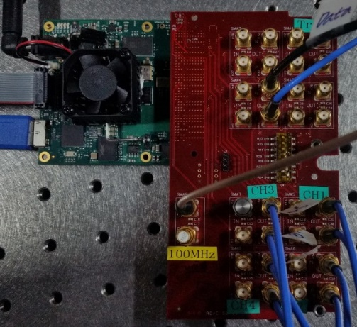
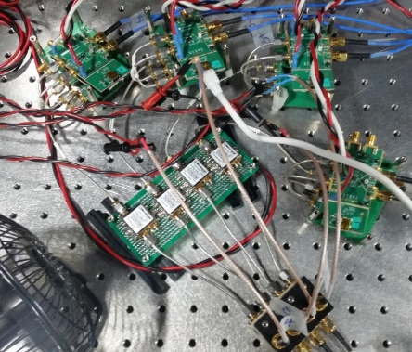
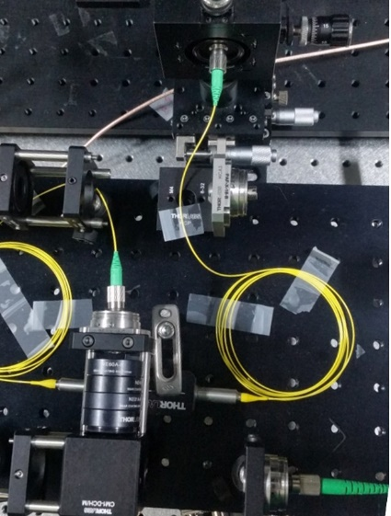
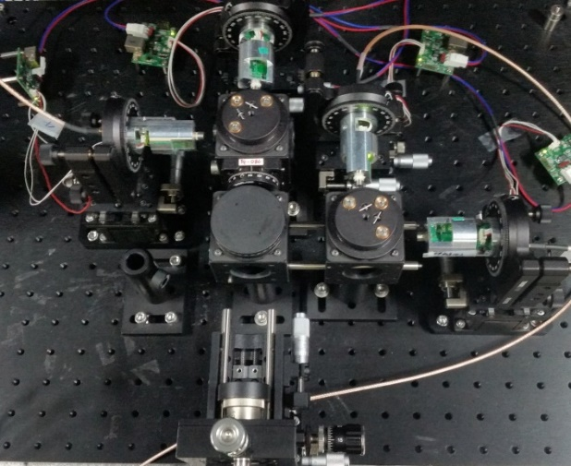
Transmitter (Alice)
Alice
FPGA
Electronics
LD3
LD4
HWP
LD2
BS
LD1
PBS
Isolator
Attn.
Sync.
Lasers
DM

Slide 5
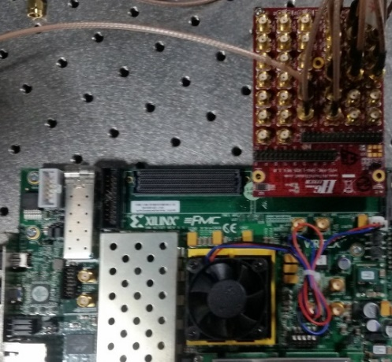
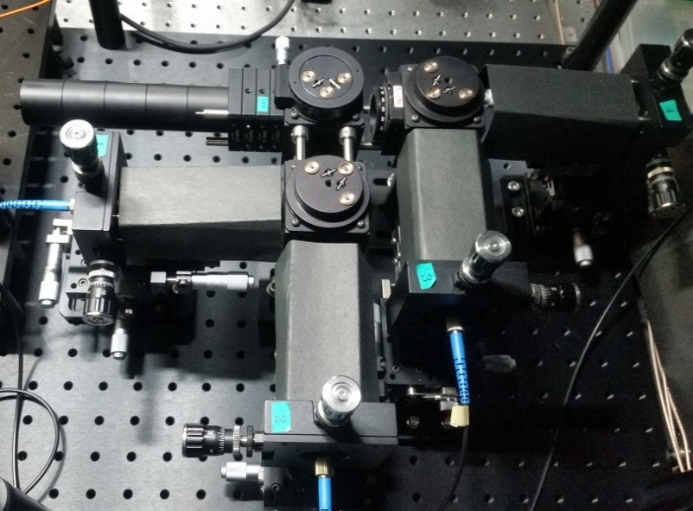
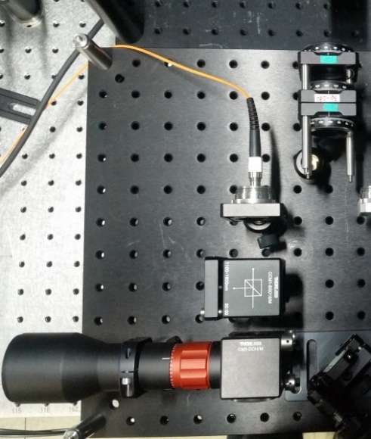
Receiver (Bob)
FPGA
Electronics
SPD4
PBS
SPD3
SPD2
BS
Filter
SPD1
Sync.
Detector
QWP
HWP
Beam
Expander
QWP
DM
M
Bob

Slide 6
System Operation Condition
Clock: 100MHz
Electrical pulse width: 400 – 500 ps
Optical pulse width: < 100 ps
Wavelength: 787.223 nm (FWHM: 0.45 nm)
Mean photon number = 0.1085
Bit generation: PRBS7
Table-Top Operation (2m channel)
Dark room condition

Slide 7
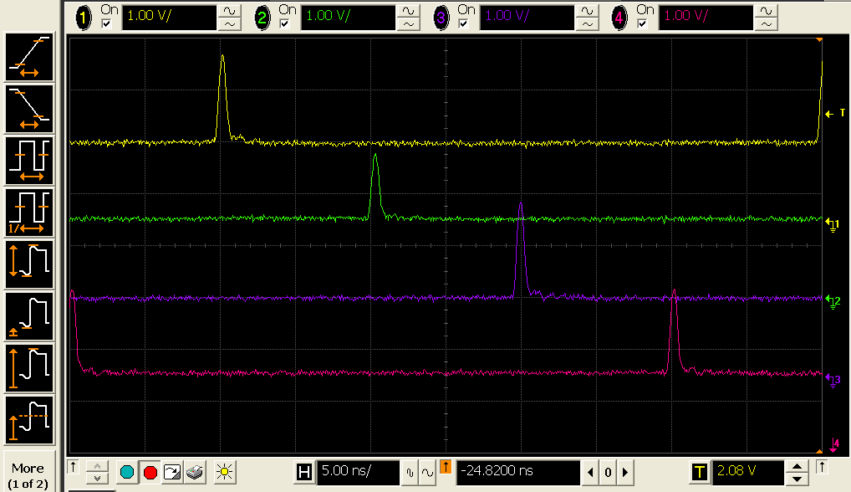
Source – Electrical Pulse
 | LD1 | LD2 | LD3 | LD4
Variable Amplifier (dB) | 7 | 3 | 7 | 6
DC bias (V) | 1.53 | 1.63 | 1.58 | 1.58
AC peak Value (V)
Clock: 100MHz
Width: 400 - 500 ps

Slide 8
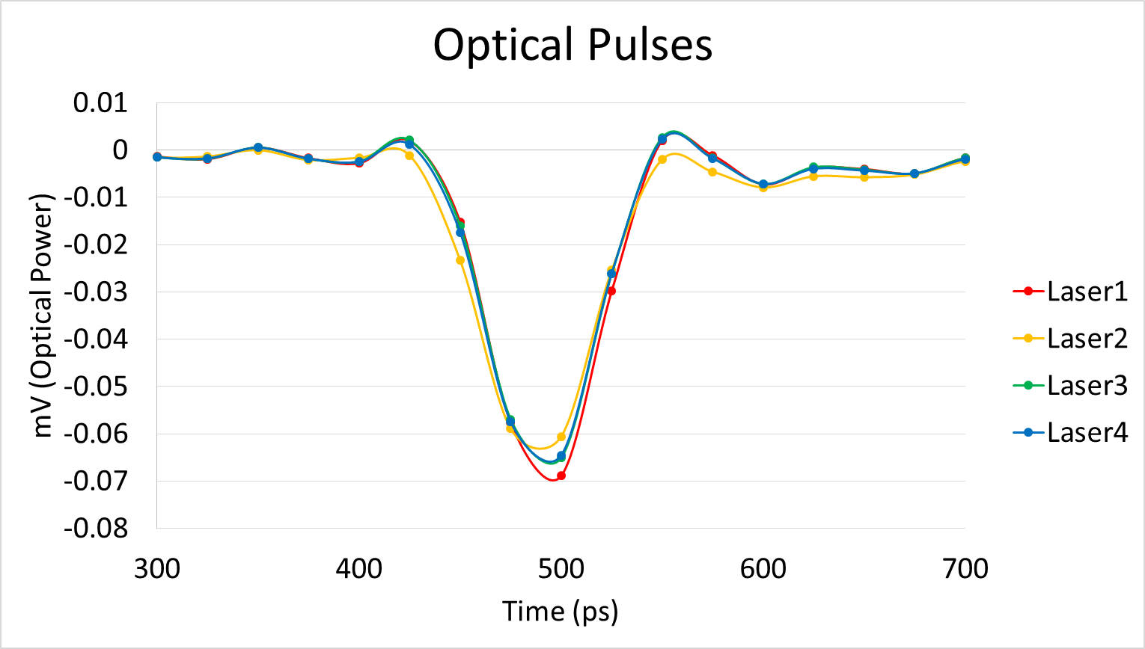
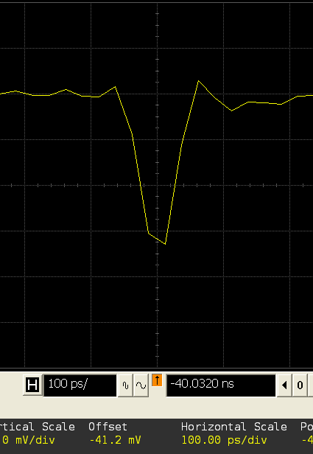



Source – Optical Pulse
Clock: 100MHz
Pulse Width: < 100 ps
Photodetector BW: 12 GHz
Oscilloscope BW: 13 GHz
Laser1
Laser2
Laser3
Laser4

Slide 9
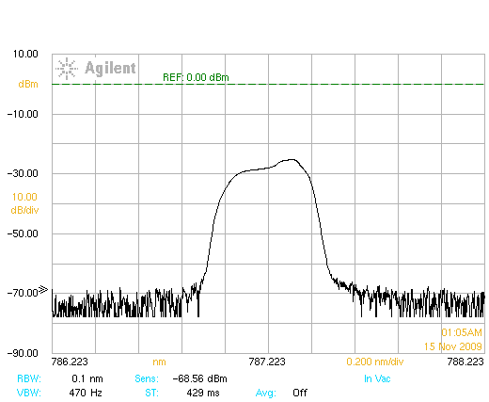
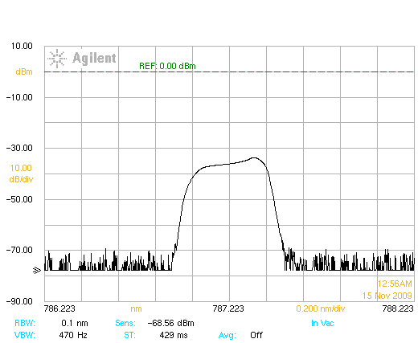
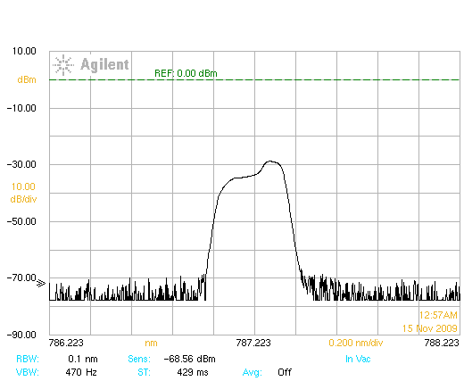
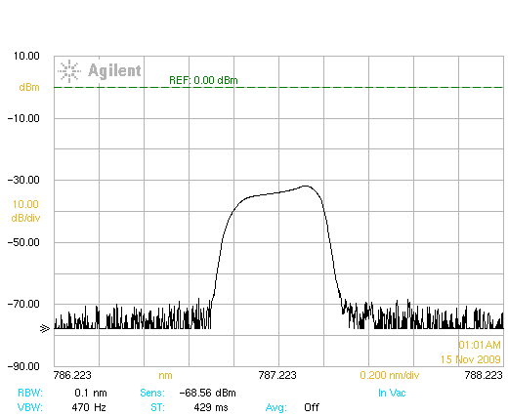

Source – Spectrum
Center Wavelength: 787.223 nm
FWHM: 0.45 nm
Temperature (°C)
LD1: 14
LD2: 34.1
LD3: 34
LD4: 26.4
All Sources
Laser1
Laser2
Laser3
Laser4

Slide 10
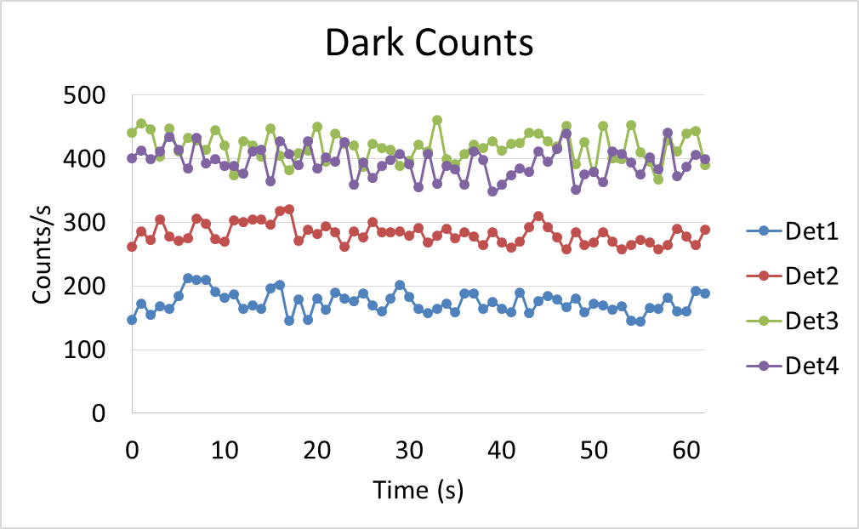
Detector Characteristics
Single photon Detector: Perkin Elmer SPCM-AQ4C
Detection efficiency: 50 % @ 787 nm
Afterpulse probability: 0.5 %
Deadtime: 50ns
Dark Count: < 500 cps
Dark Count Estimation
 | Avg. Counts | Std. dev.
Detector1 | 173.9 | 16.2
Detector2 | 281.7 | 15.1
Detector3 | 418.7 | 21.9
Detector4 | 394.0 | 22.1

Slide 11
With Bulk optics at Receiver

Slide 12
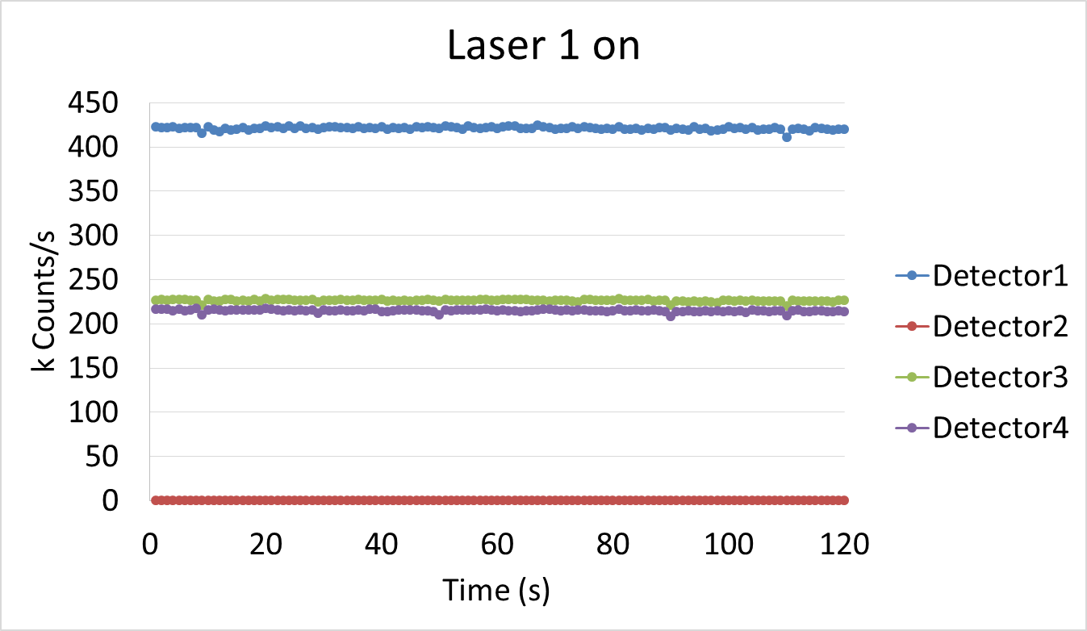
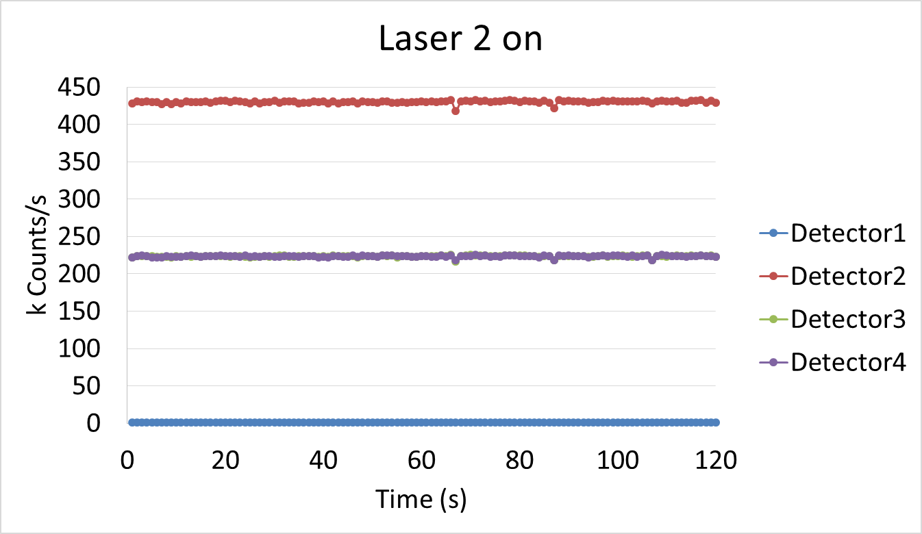
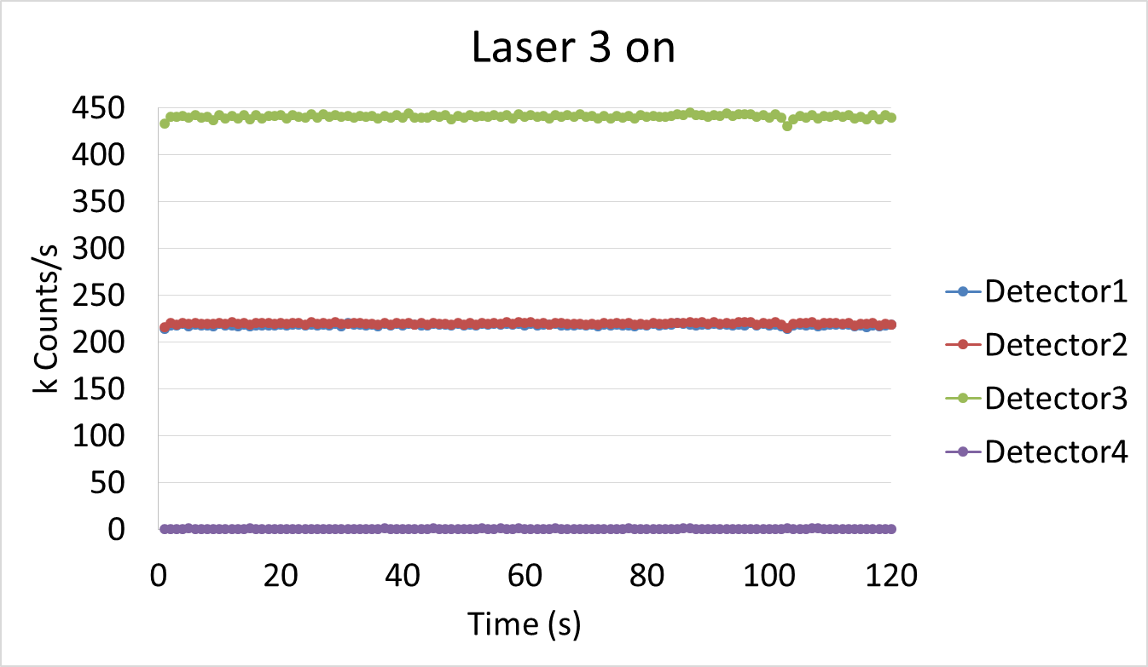
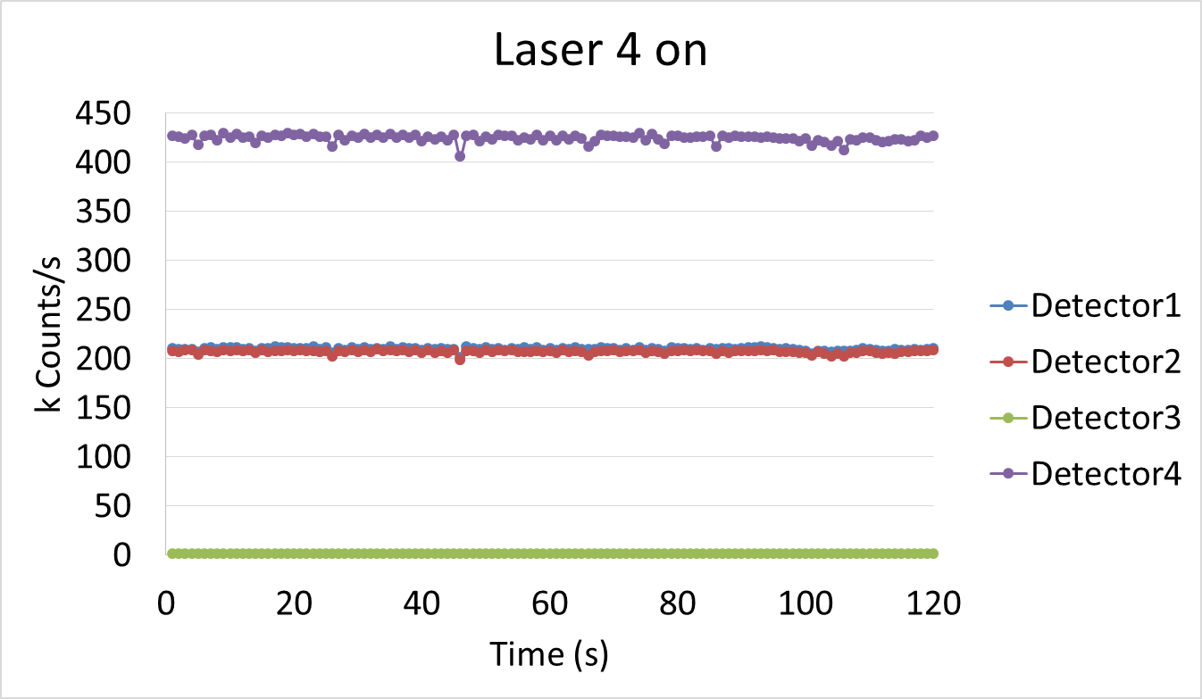
Detecting Result1 – Polarization Extinction Ratio
Counts of single photon detector output (Polarization Extinction Ratio ~ Expected QBER)
Each laser is exclusively on.

Slide 13
Detecting Result1 – Polarization Extinction Ratio (PER)
LD1 on | LD1 | LD2 | LD3 | LD4 | PER (Dark 포함) | PER (Dark 제거)
Average Counts | 421142 | 701 | 226416 | 214968 | 600.33 | 1002.74
Standard Deviation | 1669 | 27 | 1191 | 1319
LD2 on | LD1 | LD2 | LD3 | LD4 | PER (Dark 포함) | PER (Dark 제거)
Average Counts | 1045 | 430337 | 223631 | 223616 | 411.76 | 493.66
Standard Deviation | 27 | 1811 | 1170 | 1165
LD3 on | LD1 | LD2 | LD3 | LD4 | PER (Dark 포함) | PER (Dark 제거)
Average Counts | 218325 | 219919 | 440910 | 935 | 472.21 | 813.21
Standard Deviation | 988 | 995 | 1981 | 28
LD4 on | LD1 | LD2 | LD3 | LD4 | PER (Dark 포함) | PER (Dark 제거)
Average Counts | 210199 | 207421 | 1991 | 424923 | 213.33 | 269.86
Standard Deviation | 1491 | 1599 | 45 | 3616

Slide 14
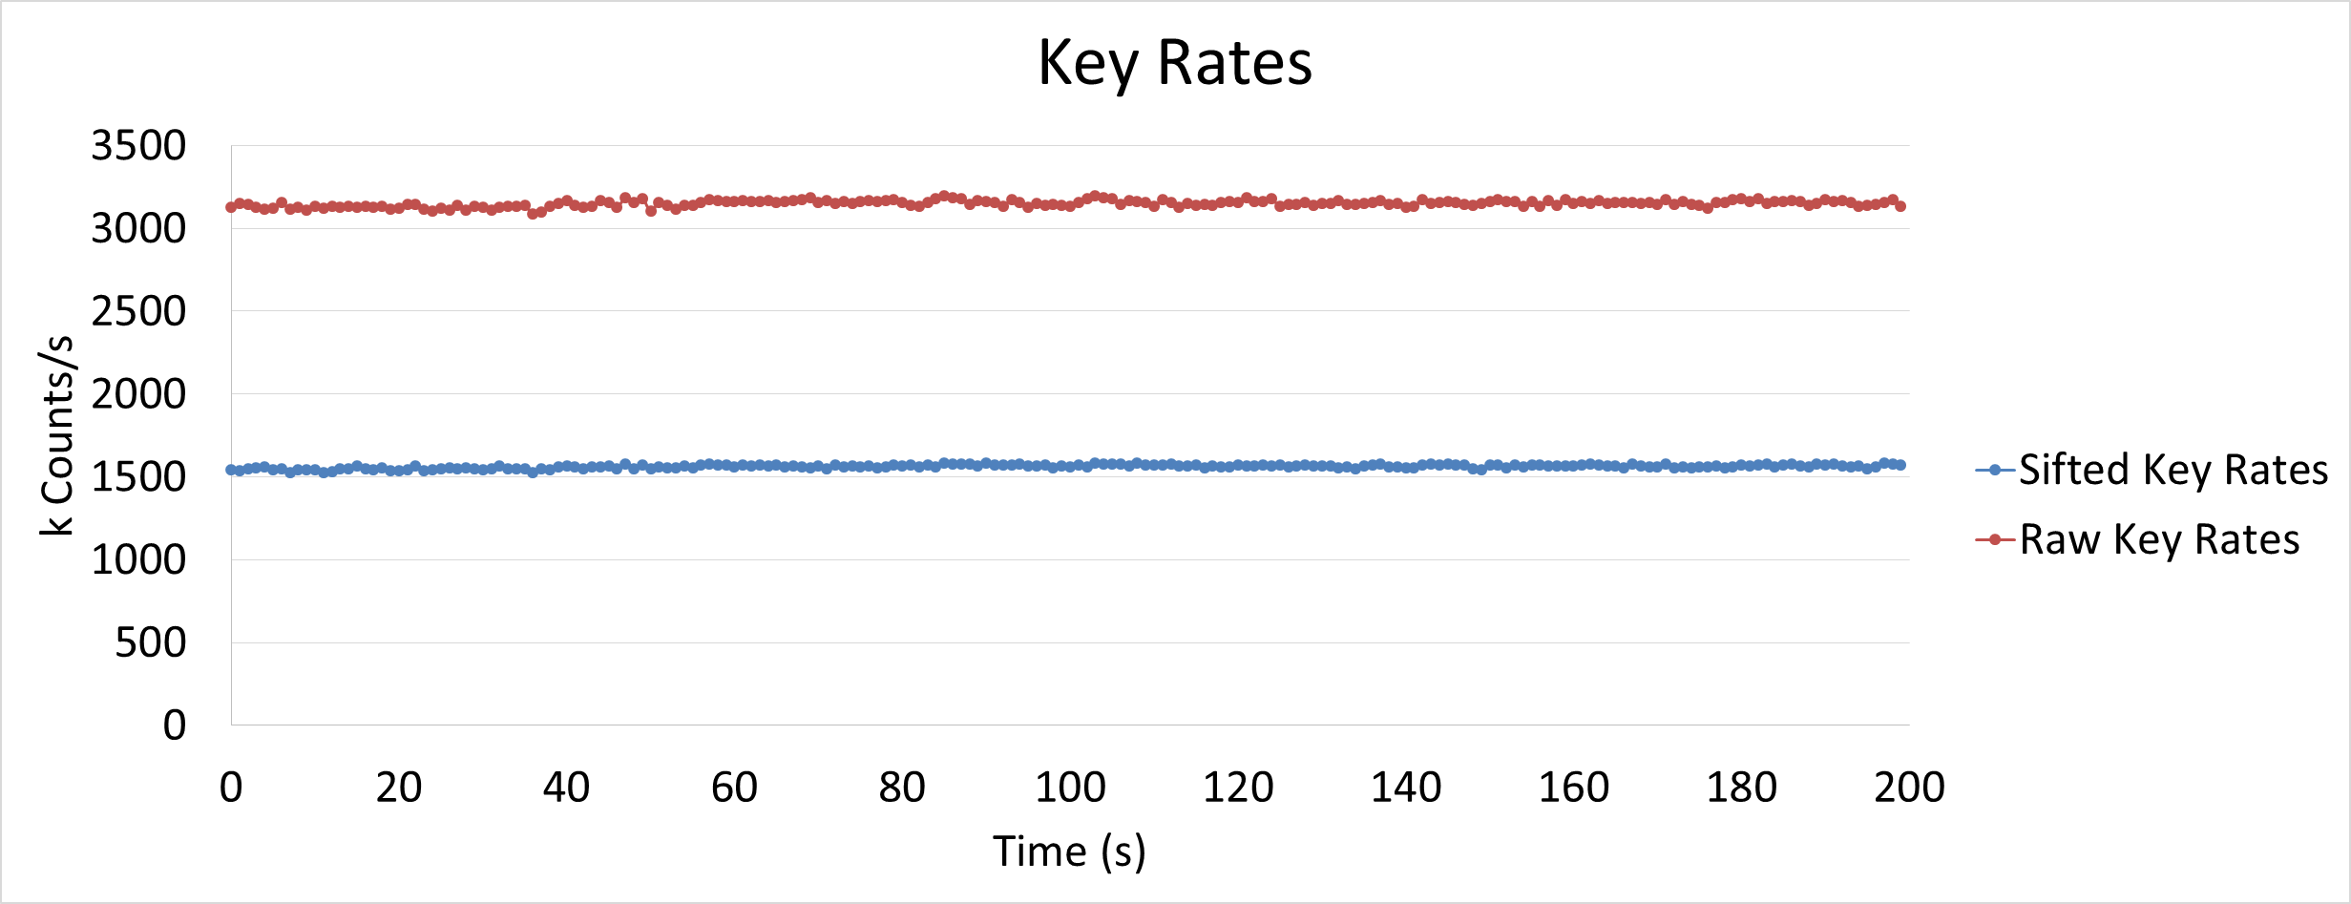
Detecting Result2 – Key Rates
FPGA Processed Data
Raw Key rates: 3149.858 kbits/s
Sifted Key rates: 1562.240 kbits/s

Slide 15
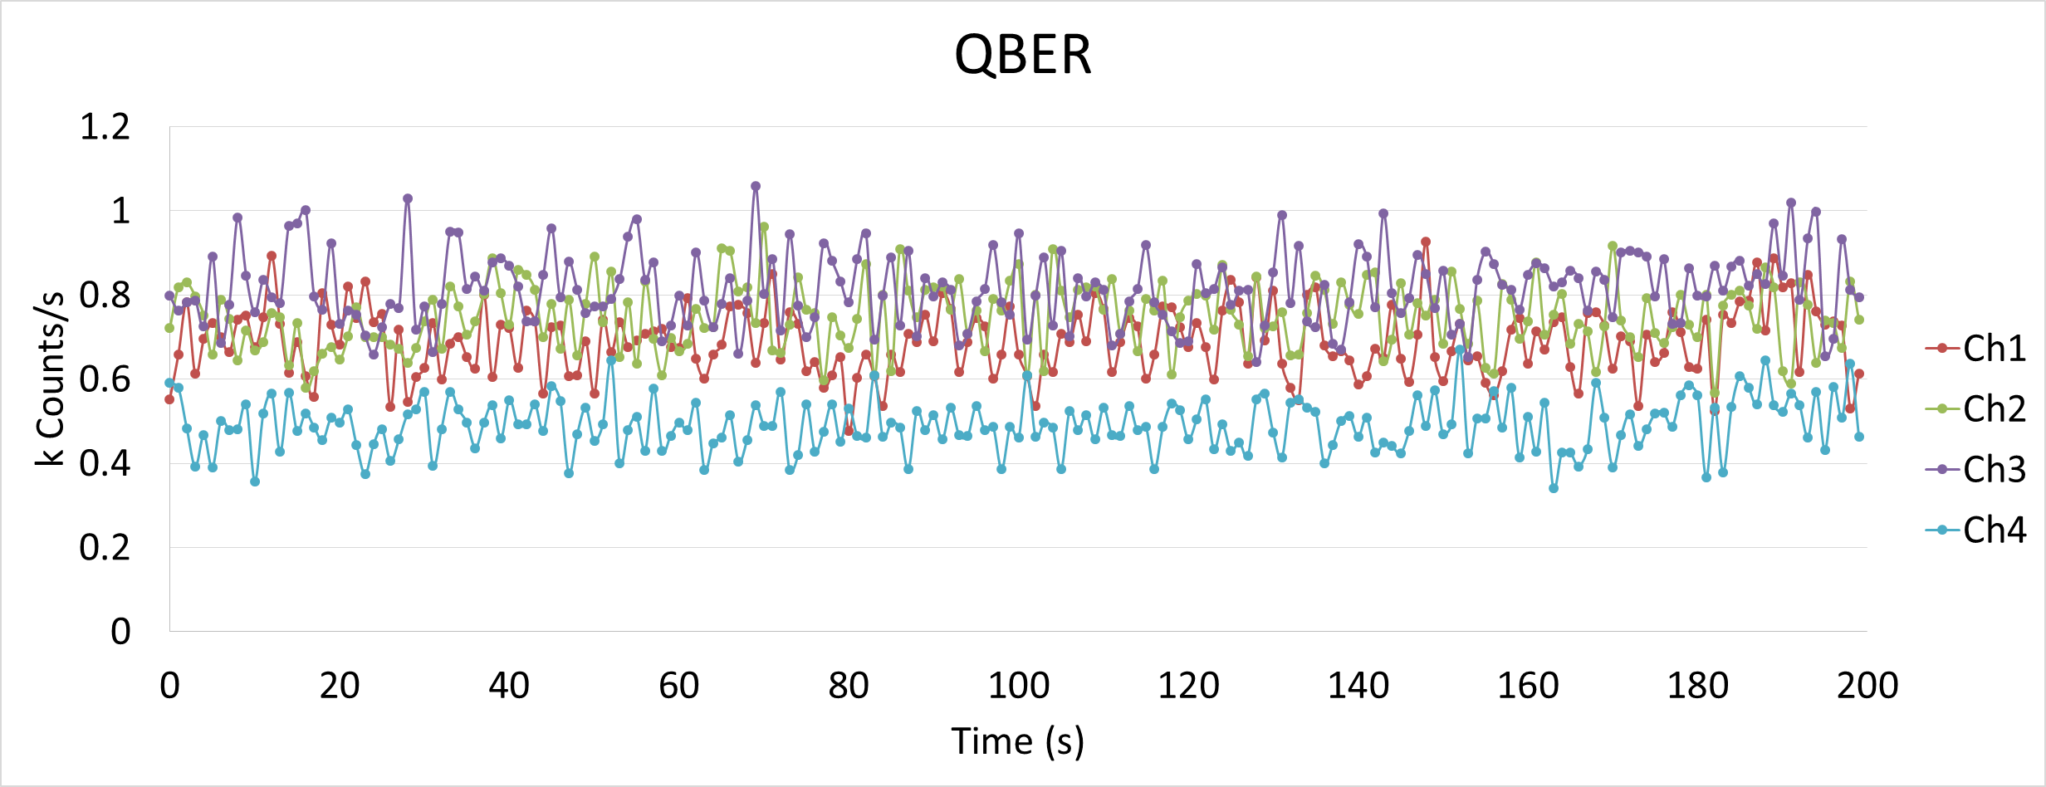
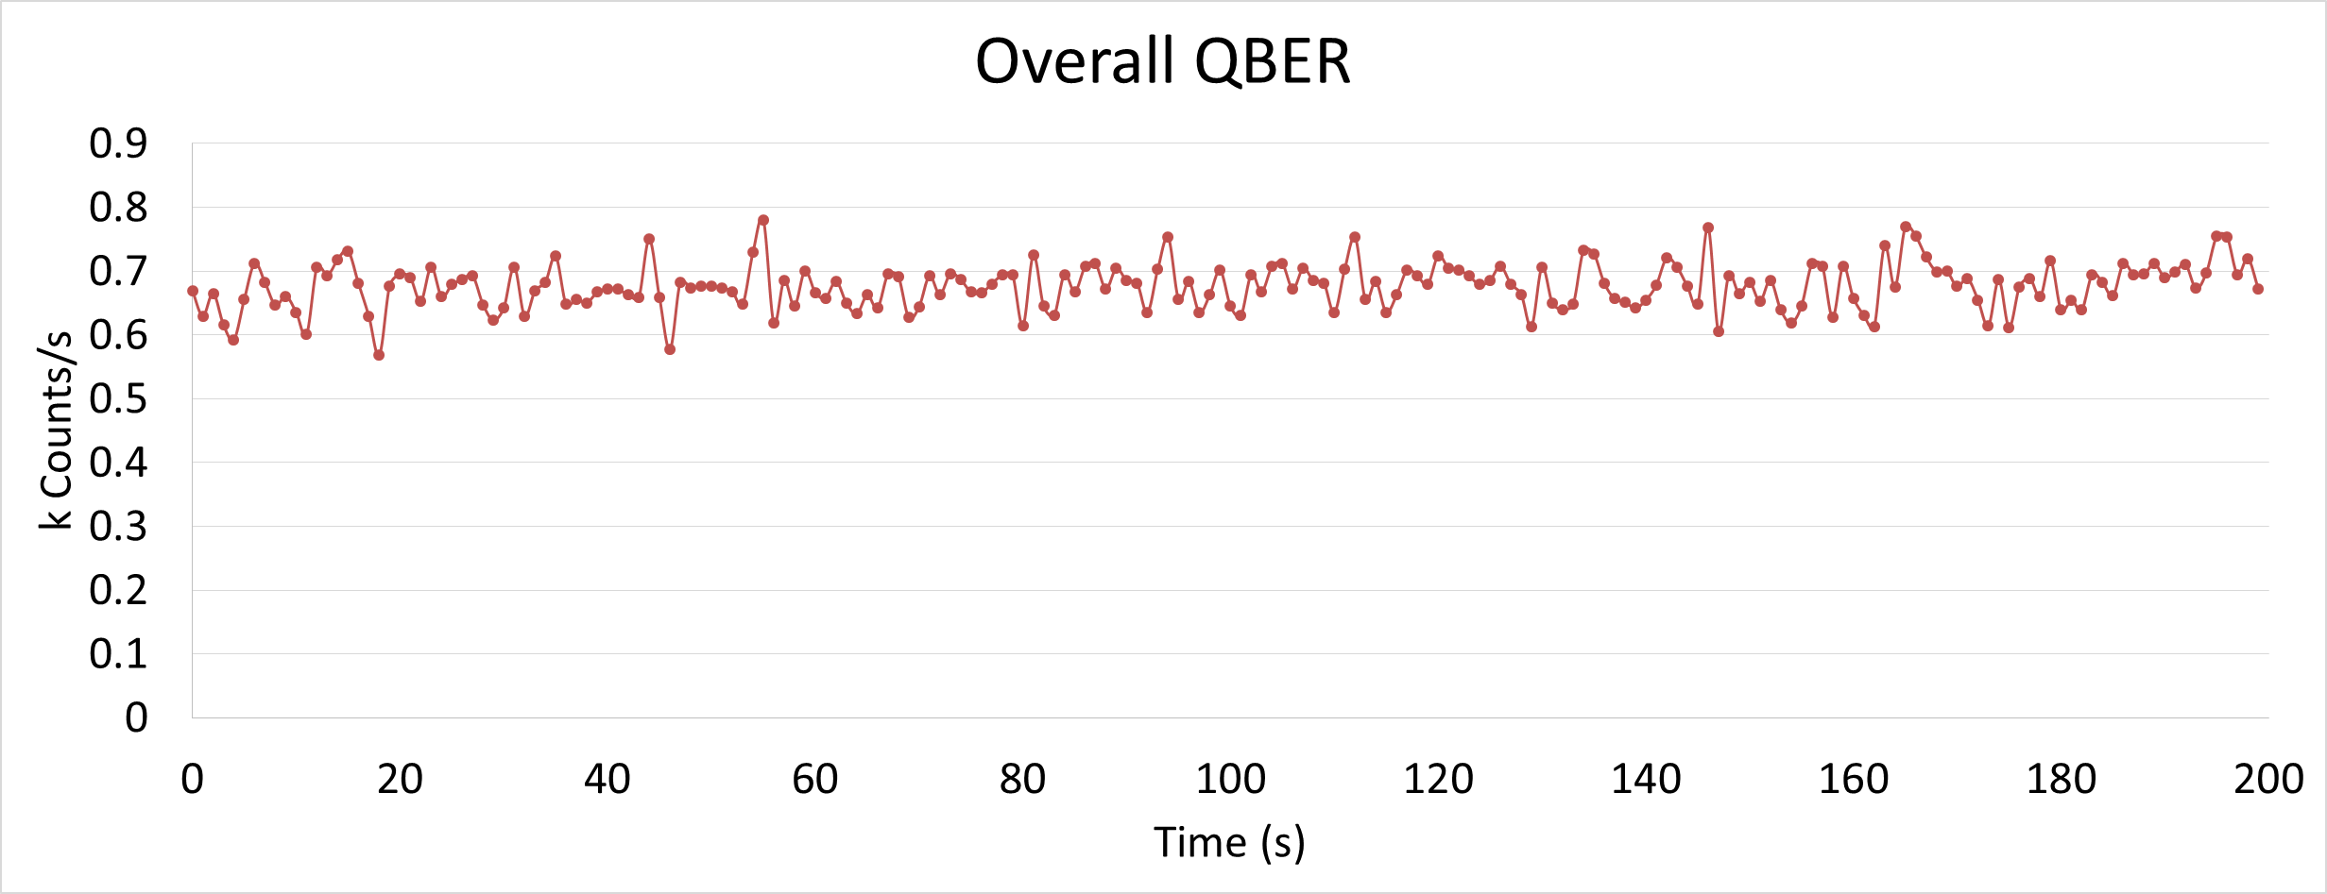
Detecting Result3 – QBER
QBER: 0.69 %

Slide 16
With PLC module at Receiver

Slide 17
Overall Block Diagram
Alice
Classical
Channel
Bob
FPGA
FPGA
Electronics
Electronics
LD3
SPD4
PLC
Module
SPD3
LD4
HWP
LD2
SPD2
BS
SPD1
LD1
PBS
Isolator
Sync.
Detector
QWP
HWP
Attn.
Sync.
Laser
Beam
Expander
QWP
M
M
DM
DM
M
Bob
780nm
Quantum
Signal
1550nm
Sync. Signal
M
Quantum Channel
M

Slide 18
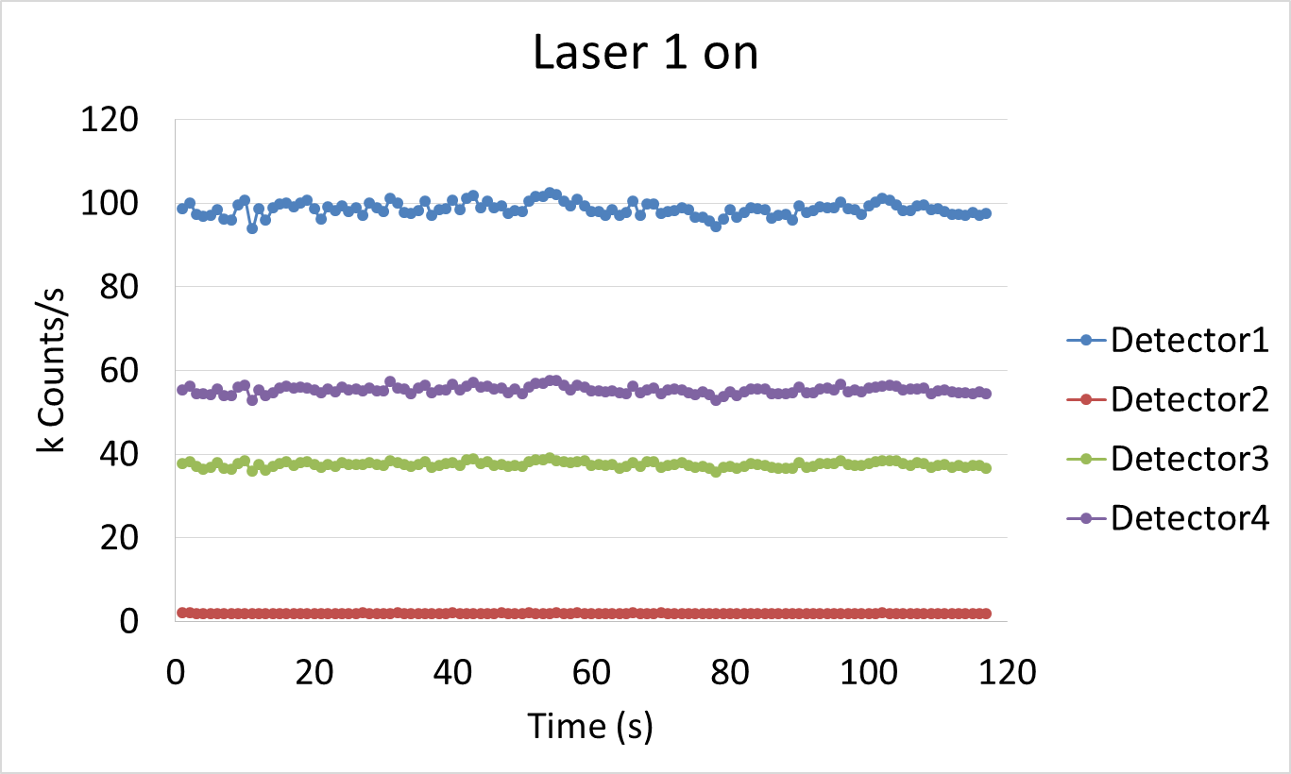
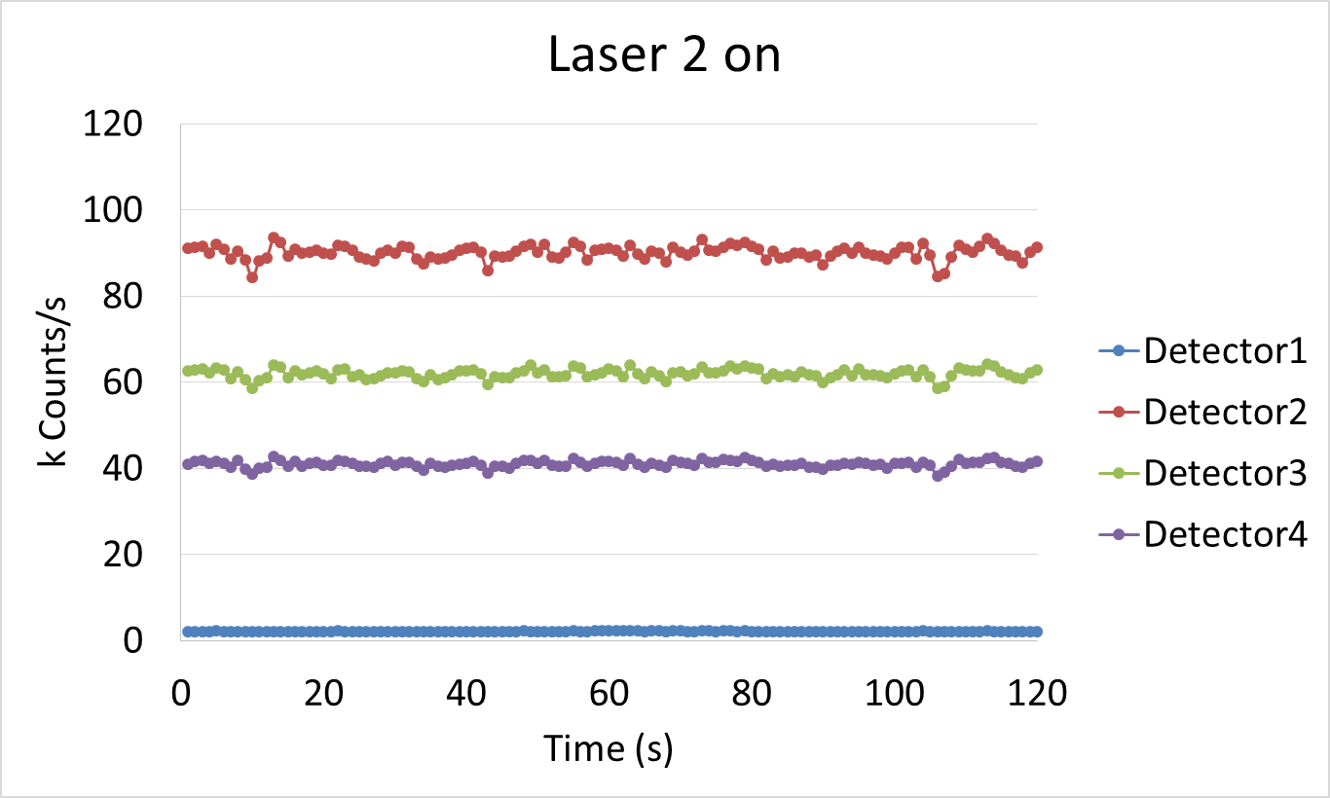
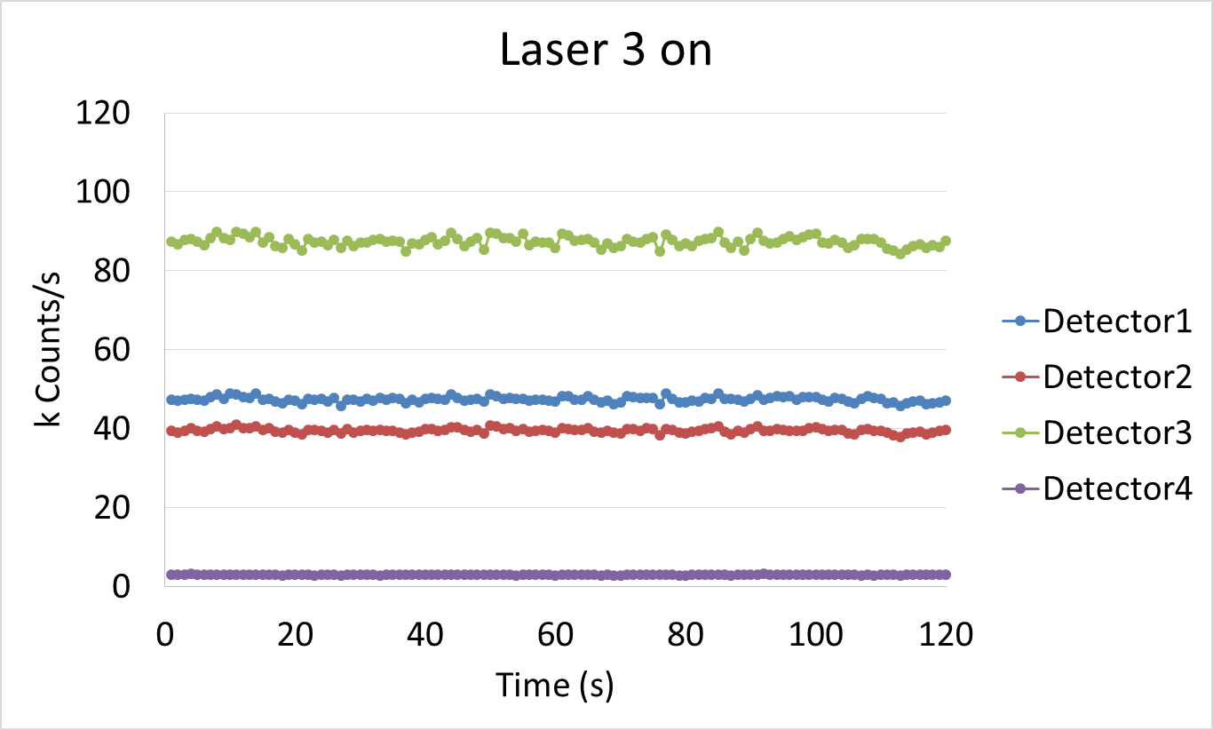
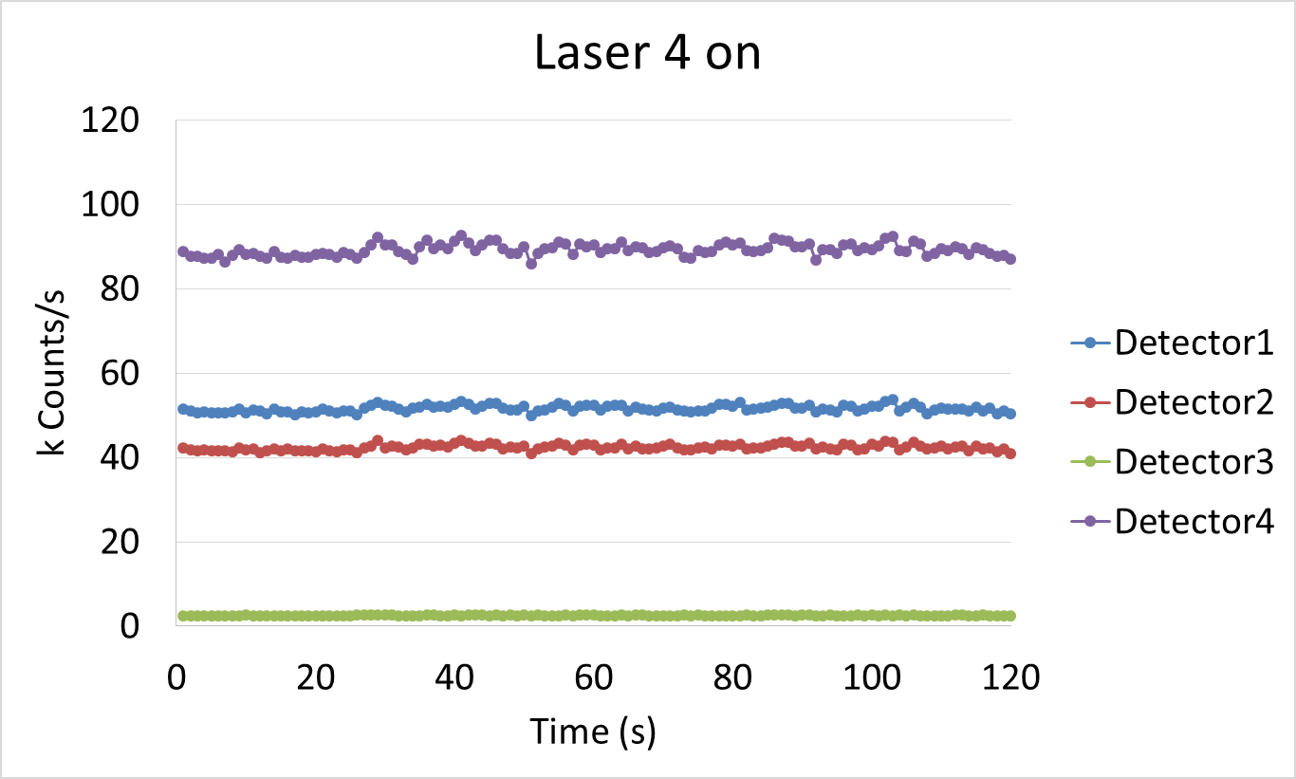
Detecting Result1 – Polarization Extinction Ratio
Counts of single photon detector output (Polarization Extinction Ratio ~ Expected QBER)
Each laser is exclusively on.

Slide 19
Detecting Result1 – Polarization Extinction Ratio (PER)
LD1 on | LD1 | LD2 | LD3 | LD4 | PER (Dark 포함) | PER (Dark 제거)
Average Counts | 98603 | 1899 | 37501 | 55354 | 51.91 | 60.84
Standard Deviation | 1580 | 53 | 635 | 875
LD2 on | LD1 | LD2 | LD3 | LD4 | PER (Dark 포함) | PER (Dark 제거)
Average Counts | 2133 | 90088 | 61960 | 41005 | 42.22 | 45.83
Standard Deviation | 67 | 1597 | 1098 | 752
LD3 on | LD1 | LD2 | LD3 | LD4 | PER (Dark 포함) | PER (Dark 제거)
Average Counts | 47437 | 39545 | 87418 | 2987 | 29.26 | 33.55
Standard Deviation | 665 | 551 | 1212 | 69
LD4 on | LD1 | LD2 | LD3 | LD4 | PER (Dark 포함) | PER (Dark 제거)
Average Counts | 51607 | 42396 | 2548 | 89264 | 35.02 | 41.72
Standard Deviation | 774 | 668 | 63 | 1398

Slide 20
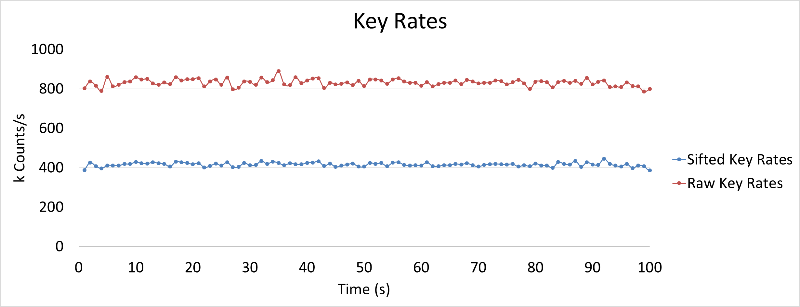
Detecting Result2 – Key Rates
FPGA Processed Data
Raw Key rates: 831.182 kbits/s
Sifted Key rates: 415.399 kbits/s

Slide 21
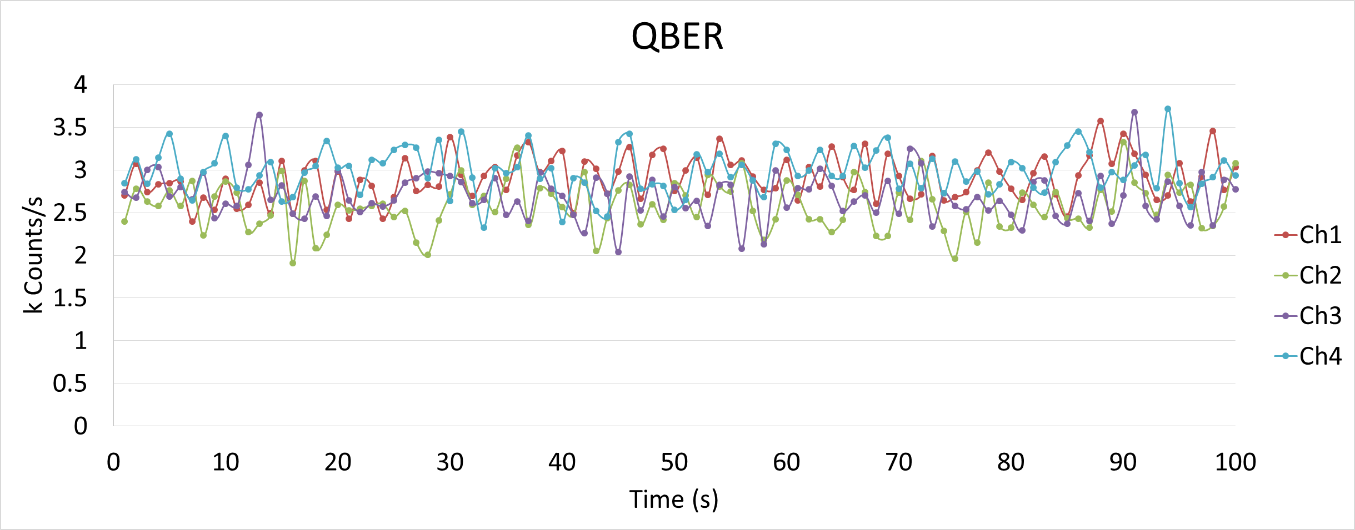
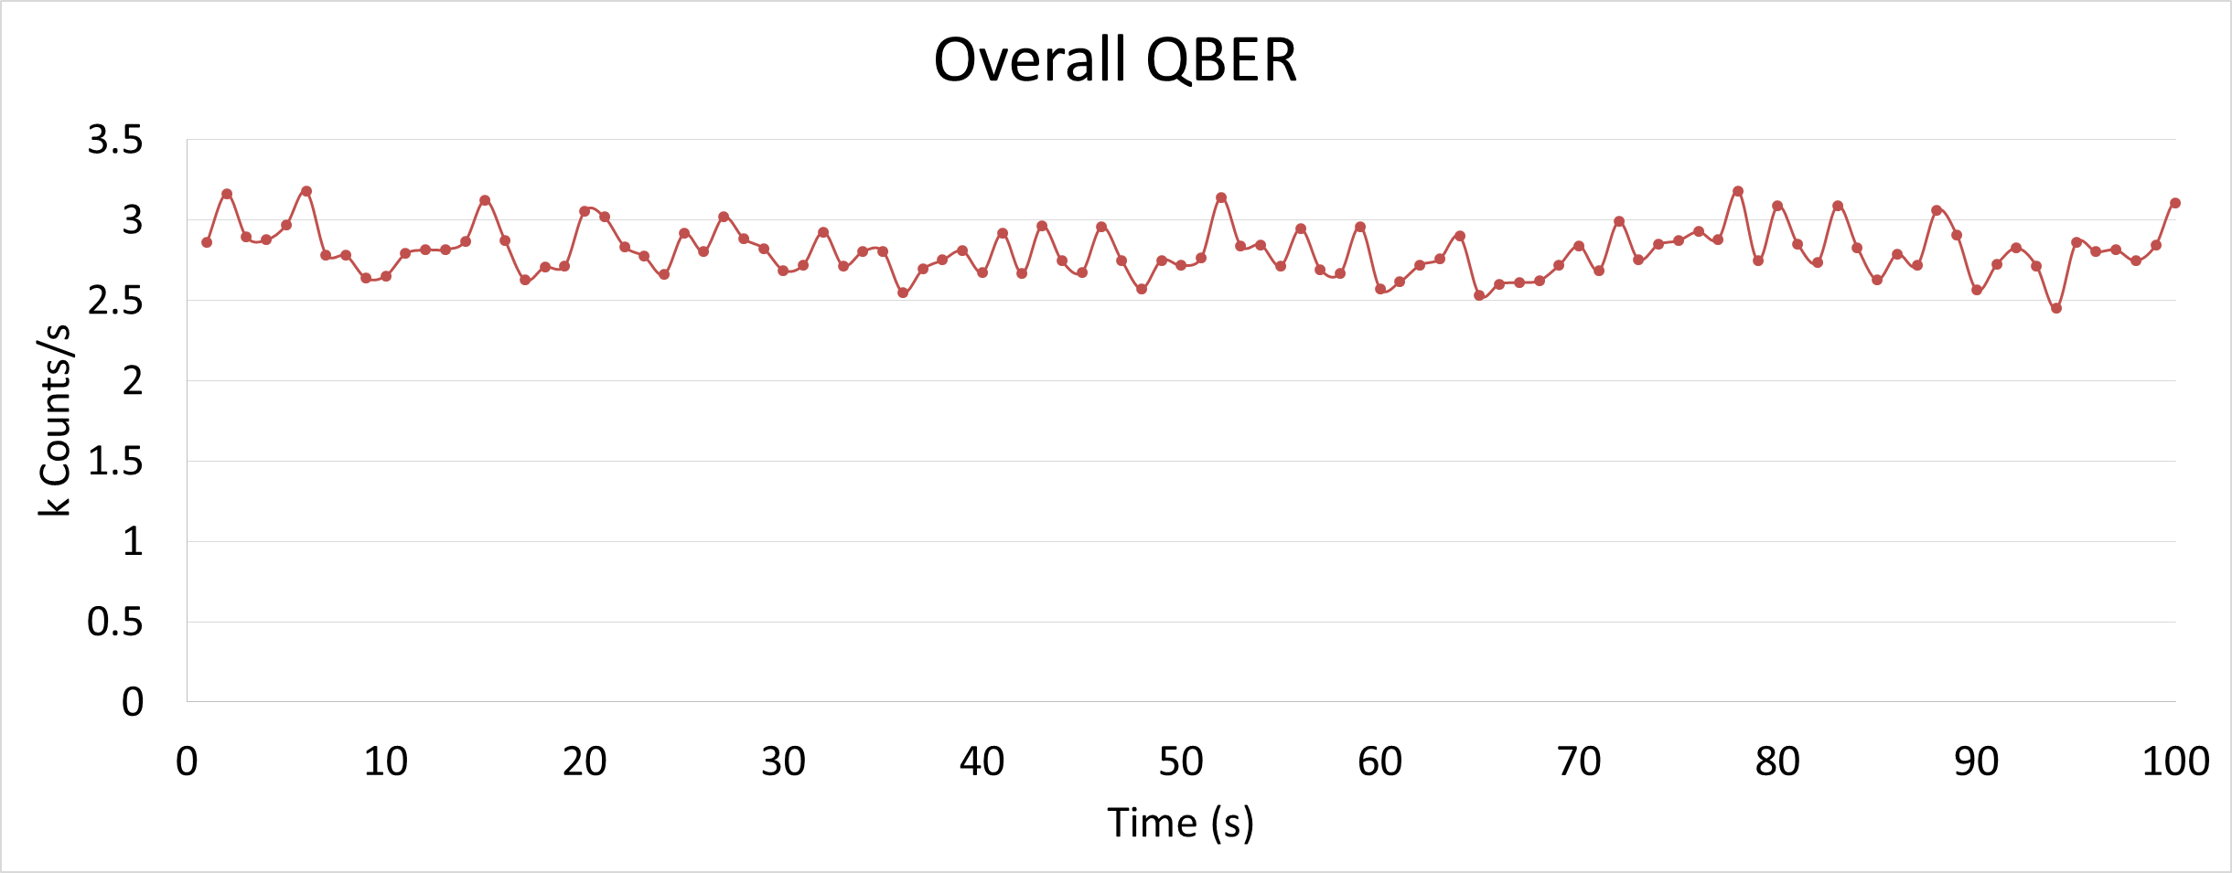
Detecting Result3 – QBER
QBER: 2.81%

Slide 22
Software Preview

Slide 23
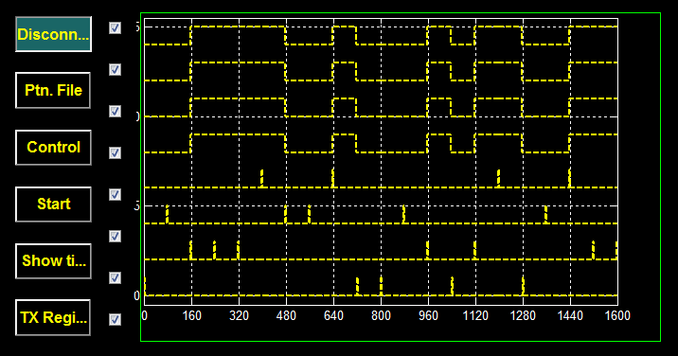
Transmitter Program
Transmitter Program

Slide 24
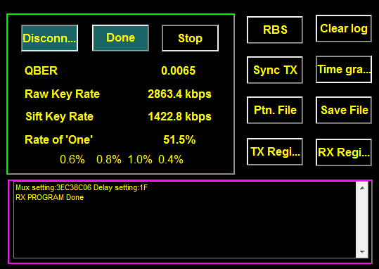
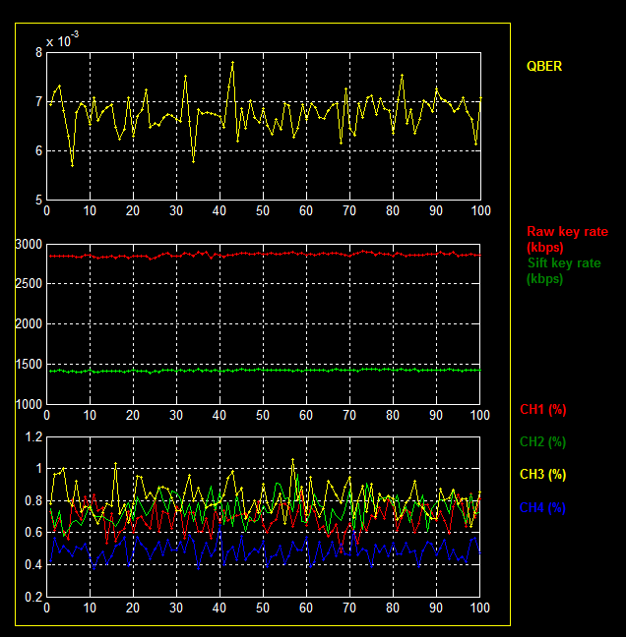
Receiver Software & Monitoring
Receiver Program
QKD Performance Monitoring

